Slide 1

L B
App ICON:-

Slide 2


LaBmAcH is a platform which provide free access to information about latest research tools and techniques of different fields of science.
Let’s Start

Slide 3

LaBmAcH
Login or register to access the content available
E-mail
Password
Login
OR
New to LaBmAcH ? Register Now

Slide 4
LaBmAcH
Login or register to access the content available
Full Name
E-mail
Password
Confirm Password
Agree with Terms and Conditions
Register

Slide 5
LaBmAcH
Register

Slide 6








LaBmAcH
Study Material
About us
Submit Request
Contribute
User

Slide 7

Study Material
Physics
Chemistry
Biology

Slide 8

Study Material
Physics
Tools
Techniques
Chemistry
Tools
Techniques
Biology
Tools
Techniques

Slide 9

Physics Tools

Slide 10
Physics Techniques

Slide 11

Biology Tools

Slide 12
Biology Techniques

Slide 13
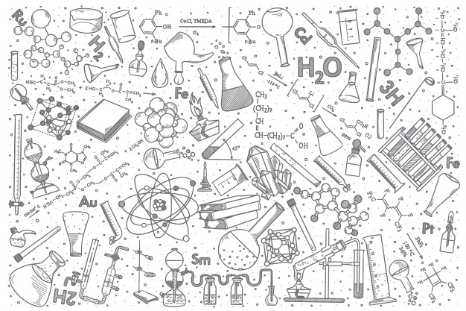
Chemistry Tools

Slide 14
Chemistry Techniques

Slide 15
Requests
Full Name
E-mail
Heading
Description
Submit Request

Slide 16
Contribute

